Slide 1
Why take Focused Notes?
Just a study tool that we hope works?
Or, can note taking be an effective method for long-term memory retention and an catalyst for increased learning and achievement?

Slide 2
Some Questions to
Think About…
Do you know HOW to take effective notes?
Do you know how to USE notes?
How can notes be most effectively used to retain relevant information?
What does the research say about effective uses of note taking?

Slide 3
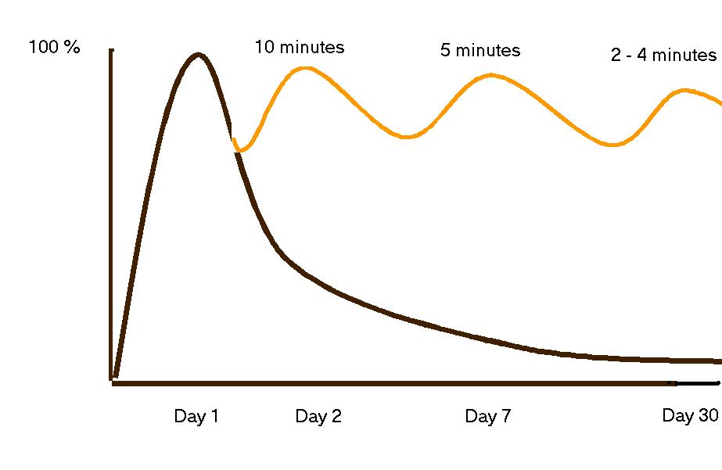
The Curve of Forgetting
The Curve of Forgetting describes how we retain or get rid of information that we take in. It's based on a one-hour lecture.
Notes without review: 97% information loss after 30 days
Notes with daily review: >80% information in long-term memory

Slide 4
Because of a block schedule, effective note taking, note interacting and note review becomes all the more important because of the greater amount of time between class sessions.

Slide 5
Four Areas of Effective Note Taking
Note Taking
Note Making
Note Interacting
Note Reflecting
Increased Student Learning and Achievement

Slide 6
Part II: Note-Making
Review and Revise Notes
Distinguish main ideas from details
Categorize information by highlighting or color coding
Delete unimportant information
Add your own thinking – fill in details to clarify, complete, or create greater meaning and understanding
Identify unclear information by using a question mark
Add references from other materials as they come to mind or make connections to other concept/content
Review for possible paper topics or test questions

Slide 7
Part II: Note-Making
Note Key Ideas to Create Questions
Write questions on the left side of your notes page that connect to key ideas
Review the main ideas highlighter on the right side

Slide 8

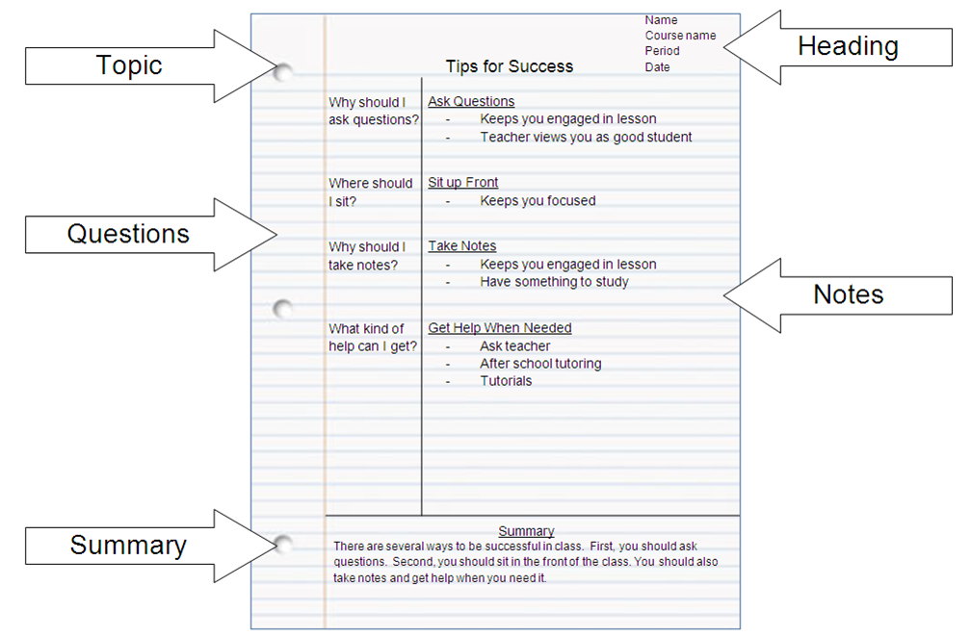
Option: Cornell Notes

Slide 9
Cornell Notes
The Essential Question…
Heading
Student created, higher level questions
Notes Section
The most common error is having students simply list terms on the left column.
The left column should be used for students to create questions: forcing them to think at a higher level and review our content!
Notes Summary

Slide 10
Other Options
Annotations
Worksheets
Graphic Organizers
Thinking Maps
Any other kind of notes

